Slide 1

Type hinting
By Min Thet Naing

Slide 2
Type hinting for arrays and objects ( PHP 5 and PHP 7)
Basic Data Types (integers, floats, strings and Booleans) support in only PHP 7
By Min Thet Naing

Slide 3
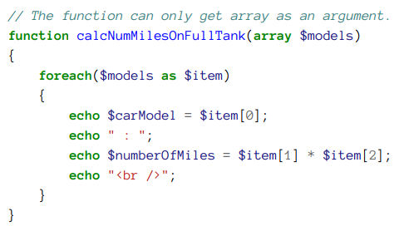
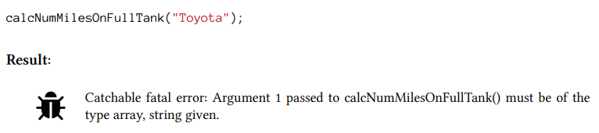
Array type hinting
By Min Thet Naing

Slide 4
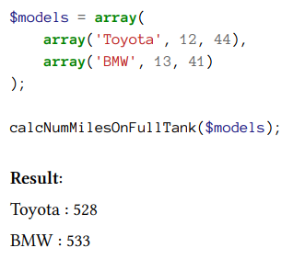
By Min Thet Naing

Slide 5
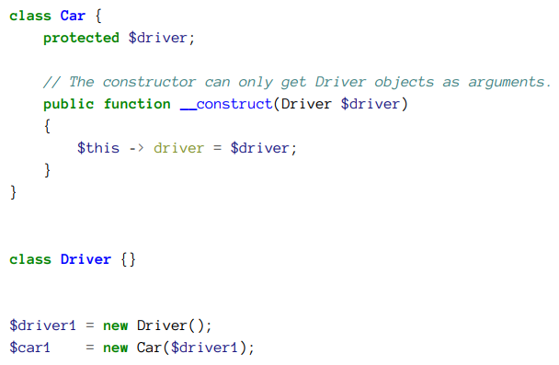
Object type hinting
By Min Thet Naing

Slide 6
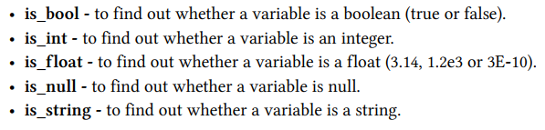
In PHP 5 we can use built-in function for type hinting for basic data types
By Min Thet Naing

Slide 7
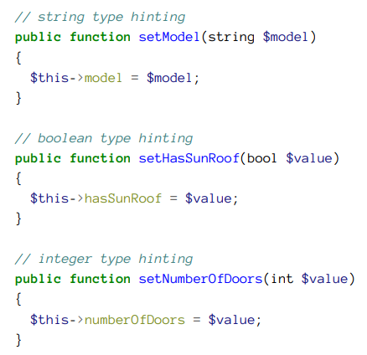
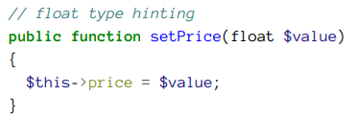
PHP 7 support scalar type hinting
By Min Thet Naing

